Slide 1
Theories of Long Term Storage: Schema Theory
Neil H. Schwartz, Ph.D.

Slide 2
How is information stored in long-term memory?
And, what relevance does storage have on the processes of comprehension --when learners are listening to a lecture, participating in a class discussion, reading a text chapter, or participating in lab?

Slide 3
Theories of information storage explain why learners interact the way they do in the presence of new material.
Schema Theory

Slide 4
Schema are:
Data structures for representing generic concepts.
Made up of images and propositions (ideas).
Hierarchical frameworks of generalised categories of information with variable “slots” containing default values that become “instantiated” with specific instances of things.

Slide 5
Schema:
Summarize the redundancy in our experiences.
Represent what is generally true about things.
Allow us to store information efficiently.
Provide contexts for interpretation.
Allow us to comprehend unfamiliar information.
Are generic abstractions about the world.
Are idiosyncratic, experience-based, and personal.

Slide 6
Consider a simple word:
G R O U N D S
What schema do you access to interpret it?

Slide 7
A beautiful estate

Slide 8
Your morning coffee

Slide 9
How about the
9th Circuit Court of Appeals?

Slide 10
Schema provides learners with context
for interpreting new information.
Schema also provides learners with the
information they will need to make
new information comprehensible.

Slide 11
Consider a simple paragraph
from a college text:
“The template is apparently a non-DNA system that directs the molecules in such a way that they conform to a particular pattern. If a mutant type that is curly is dissolved and precipitated again, it will take the pattern of the ‘template’ that provides the information for restoring the structure.”

Slide 12
Or, perhaps a simpler text:
“If the balloons popped, the sound wouldn’t be able
to carry since everything would be too far away from
the correct floor. A closed window would also prevent
the sound from carrying, since most buildings tend to be well insulated. Since the whole operation depends on a steady flow of electricity, a break in the middle of the wire would also cause problems. Of course, the fellow could shout, but the human voice is not loud enough to carry that far. A string could break on the instrument. Then there could be no accompaniment to the message. It is clear that the best would be less distance. With face to face contact, the least number of things could go wrong.”

Slide 13
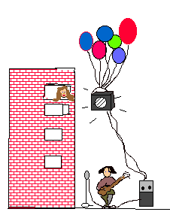
Perhaps, this graphic helps...

